Slide 1
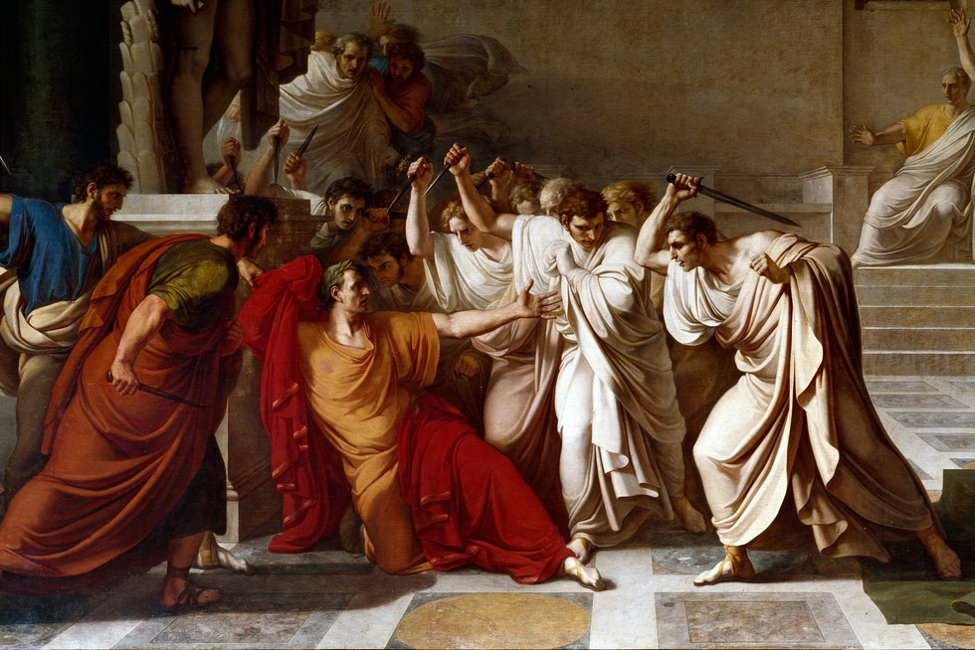
Rome – MILITARY and ECONOMIC Structures
GOAL/S: Identify and describe Roman Military and Economic Structures
Week 3, Lesson 1

Slide 2

This week:
Roman MILITARY structures
Roman ECONOMIC features
Historical Context – What was actually going on in Rome?

Slide 3
Economic Structures
Ancient rome

Slide 4

Economic Structures
Create a mindmap of the following economic structures

Slide 6
TEACHER ONLY
Agriculture: The Roman economy was primarily agrarian, with a focus on large-scale farming. The fertile soil of Italy and the use of innovative agricultural techniques, such as the Roman plow, contributed to high agricultural productivity.
Slave Labor: Slavery played a crucial role in the Roman economy. Slaves were used in various sectors, including agriculture, mining, and domestic service. The availability of cheap slave labor allowed for the expansion of large estates and increased economic output.
Trade and Commerce: Rome's strategic location on the Mediterranean facilitated extensive trade networks. The Romans engaged in both local and long-distance trade, importing goods such as spices, silk, and precious metals from distant regions. The construction of an extensive road network and the use of the Mediterranean Sea for transportation further facilitated trade.
Coinage and Currency: The Romans used a system of coinage, with the denarius being the most common silver coin. The Roman government controlled the minting of coins, providing a standardized currency that facilitated economic transactions and trade.
Urbanization: The Roman Empire was characterized by significant urban development. Cities served as administrative centers, hubs of economic activity, and cultural focal points. Rome, in particular, became one of the largest and most influential cities in the ancient world.
Government Involvement: The Roman state played an active role in the economy, especially in areas such as taxation, regulation of trade, and infrastructure development. The government sought to ensure stability and support economic growth through various policies.
Mining and Industry: The Romans were adept at mining, extracting resources such as gold, silver, iron, and lead. They also had a nascent industrial sector, including textile production and pottery manufacturing.
Specialization of Labor: In urban areas, there was a trend towards specialization of labor, with individuals focusing on specific crafts or trades. This specialization contributed to the development of a diverse and interconnected economy.
Financial Instruments: Romans developed various financial instruments, including the use of credit, banking, and partnerships. This allowed for more complex economic transactions and investment activities.
Decline and Transformation: As the Roman Empire faced internal and external challenges, the economy underwent changes. Factors such as overreliance on slave labor, excessive taxation, and political instability contributed to economic decline in certain regions.

Slide 7
Military Structures
Ancient rome

Slide 8
Military service was a part of life for Roman citizens. It was needed at first to help increase Rome’s territory and then to defend it. In fact, for a time the most important Roman god was Mars – the god of war. Through intense and disciplined training, Rome’s army became very strong. Later, the breakdown in order and self-discipline in the army was one of the reasons Rome’s Western Empire eventually crumbled.

Slide 9
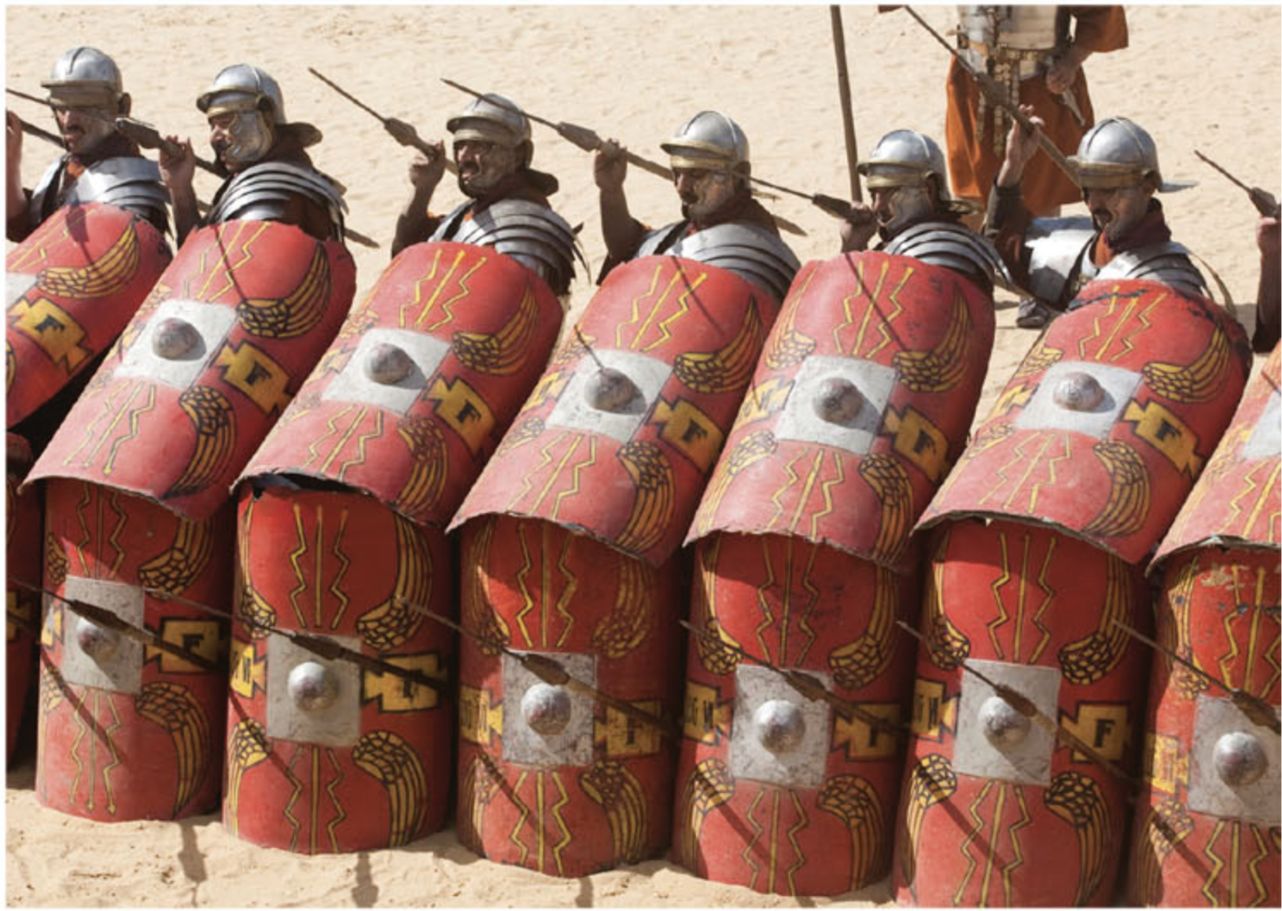
DISCUSSION: What does this source teach us about Roman warfare?
Notes:
The testudo (from the Latin word for 'tortoise shell') provided Roman soldiers with protection against enemy attacks. Their shields were sometimes held above their heads when approaching the walls of an enemy fort.

Slide 10
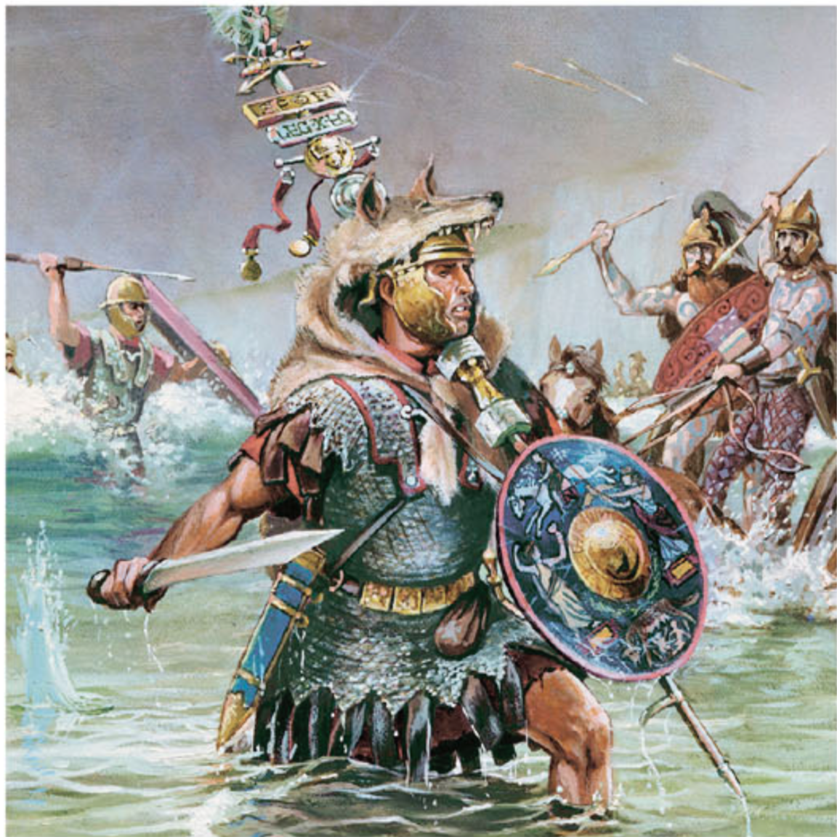
DISCUSSION: What does this source teach us about Roman warfare?
Notes:
A modern artist's impression of an aquilifer, or standard-bearer, leading his men into battle

Slide 11
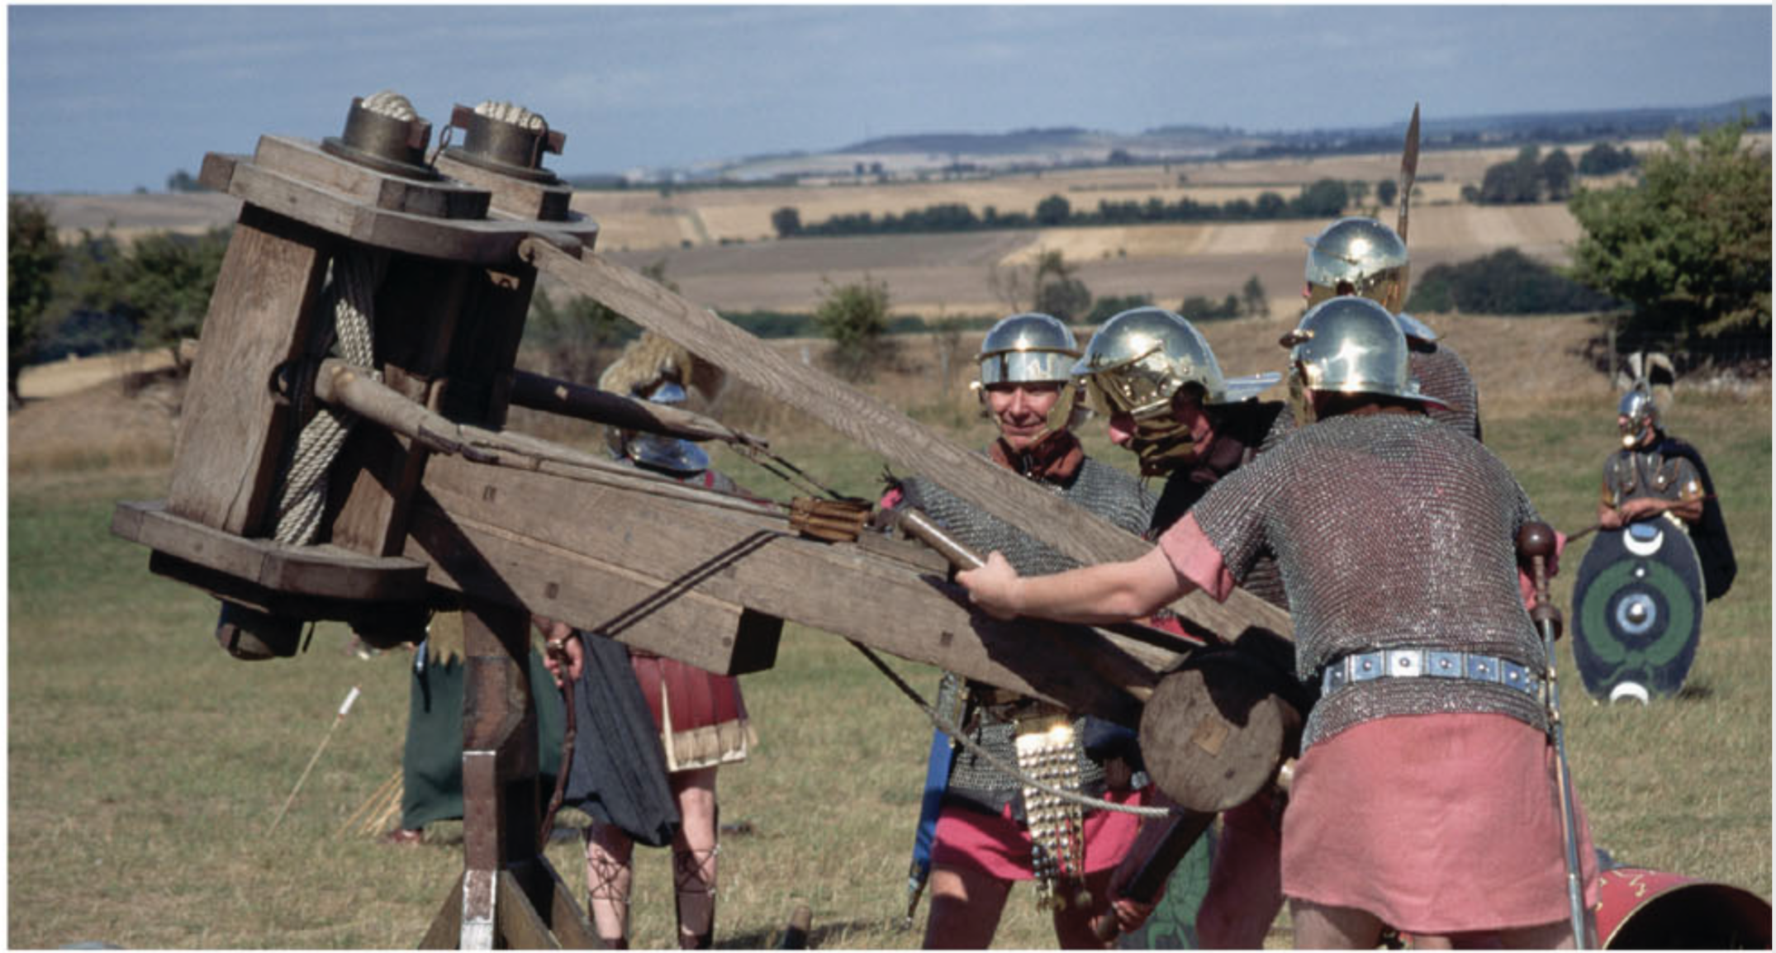
DISCUSSION: What does this source teach us about Roman warfare?
Notes:
A modern re-enactment of Roman soldiers loading a ballista, a type of catapult

Slide 12
WARFARE – Early Days
men had to be landowners to enter army
wealthy – horses, weapons, armour (formed the CAVALRY)
260BCE – gained control of Italy
10BCE – Roman Consul Marius – no longer needed to have land to join
WHY do you think this change might have occurred?

Slide 13
WARFARE – Organisation
hierarchical and disciplined
Soldiers – legionaries
General – legatus
Groups – cohorts
Cohorts broken down into smaller groups – centuries
Soldier leading a century – centurion
Roman citizen joined – auxillaries (special skills – archery, front line)

Slide 14
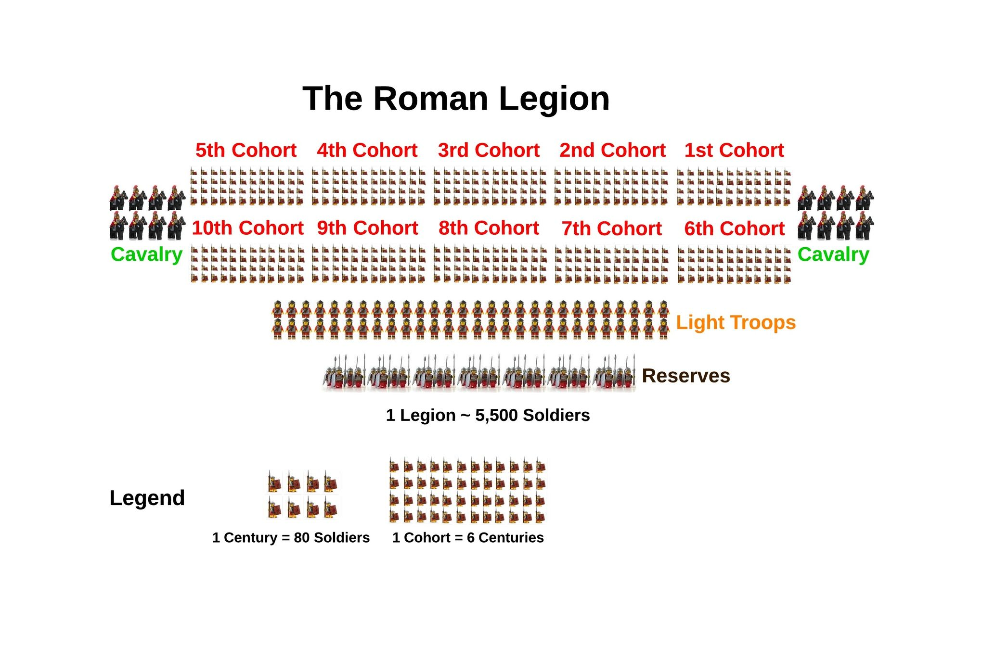
Notes:
Army – 30 legions
Legion – 4000-600 men led by Legatus (General)
Legion – made up of about 10 cohorts – broken down into smaller groups of 80-100 (centuries)
Century led by centurian

Slide 15
WARFARE – Organisation
Organised by age – youngest at front
Woolen tunic, body armour, iron plates, helmet, belt, leather sandals
dagger, sword, javelin (spear), large shield

Slide 16
Each legion of the Roman army carried a standard into battle. A Standard was a silver eagle called an Aquila mounted on a pole that identified each legion. It was a symbol of their strength and therefore a matter of great shame if the standard was lost or captured. This could destroy the morale and discipline of the legion on the battlefield. There were several standard-bearers in Rome’s army who were chosen for their leadership qualities. They were known as aquilifer, because they carried the aquila.

Slide 17
WARFARE – Siege
STRATEGIES
surrounding enemy city and starving into submission by building two walls (inner – barrier to supplies, outer – protect Roman troops)
slaughtering after surrender
Catapults (stones, rotting animals to spread disease) and battering rams
Dig tunnels under weak section of wall to collapse it

Slide 18
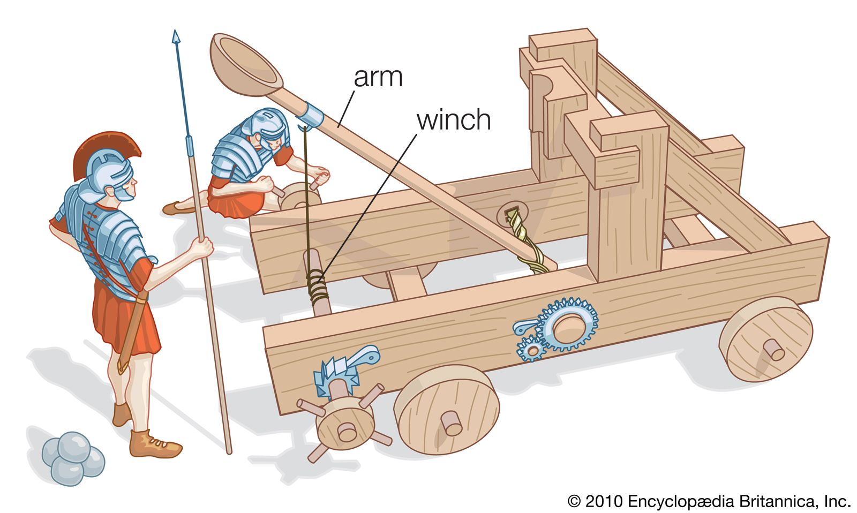
Make a catapult
Activity – who can launch the furthest?

